Slide 1

Hardware
Design and Development of Charge Monitoring & Fire protection for Electrical Vehicle using IOT
SOC Review-III
Batch No-14
Presented By
N.HEMASRI – 22B01A0241
CH.NAVYA – 22B01A0215
P.PRASUNA – 22B01A0250
M.JHANSI _ 23B05A0206
Supervisor
Mr. M.S.R.GANESH
Asst. Professor, EEE
Department of Electrical & Electronics Engineering
Shri Vishnu Engineering College for Women (A)
Bhimavaram, Andhra Pradesh - 534202

Slide 2
CONTENTS
Introduction
Literature Review
Problem Statement
Objectives
Block Diagram
Components
Mathematical Analysis / Model Design
Gantt Chart
References

Slide 3
Introduction:
Imagine a future where electric vehicles not only redefine transportation but also prioritize safety and efficiency through cutting-edge technology. Our project delves into the design and development of an IoT-based system that not only monitors the charging process of electric vehicles but also ensures robust fire protection measures. we explore how innovation in IoT is reshaping the landscape of electric vehicle safety and performance.

Slide 4
Literature Review
SL. No | Title and Author’s | Paper Details | Description | Key Findings
1. | Title : IoT-Based Electric Vehicle Battery Monitoring System at Charging Stations Author: Mohammed Hamza, Ishant Kumar Bajpai, Shoukath Cherukat | IEEE Charge monitoring and fire protection, Vol. 72, no. 2, 2021 pp. 1275-1289, | This book provides a comprehensive overview of the design and implementation of IoT-based systems for monitoring and managing the battery life and charge status of electric vehicles. It emphasizes the integration of IoT technologies to ensure safety and efficiency in EV battery management, especially in the context of charging stations. | IoT Integration: Explores the role of IoT in real-time battery monitoring and management.- Safety Mechanisms: Details advanced safety features, including fire protection mechanisms.- Charging Optimization: Discusses algorithms and systems for optimizing charging processes and improving battery lifespan.- Case Studies: Includes practical case studies and examples of IoT applications in EV charging stations.
2. | Title : IoT-Based Monitoring and Management of Electric Vehicle Charging Systems for DC Fast Charging Facility" Author’s : Asaad M., Ahmad F., Alam M. S., Rafat Y. | IEEE Access, Mobile Networks and Applications, Vol. 23, Issue 4, 2018 pp: 994-1005 . | This paper investigates the use of IoT for monitoring and managing the charging of electric vehicle batteries, particularly focusing on DC fast charging facilities. It addresses the challenges of ensuring battery health and safety while achieving efficient energy use. | Real-time Monitoring: Highlights the importance of continuous monitoring of battery parameters using IoT sensors.- Fire Safety: Discusses strategies for detecting and preventing potential fire hazards during the charging process. Energy Management: Examines methods for optimizing energy consumption and reducing charging times.- System Architecture: Provides an overview of the system architecture and communication protocols used in IoT-based EV charging systems.

Slide 5
SL. No | Title and Author’s | Paper Details | Description | Key Findings
1. | Title : A Review of Battery Fires in Electric Vehicles Author: Peiyi SunThe Hong Kong PolytechniUniversityRoeland BisschopVolvo Energy ABHuichang Niu | January 2020Fire TechnologyJanuary 2020DOI:10.1007/s10694-019-00944-3 | EV fire is harder to suppress because of the potential re-ignition of battery and the difficulty in cooling the battery pack inside. For the suppression of EV fire, water is still considered as most effective, and a significant amount of water is required to extinguish and cool the battery. However, less suppressant can be used if it is directly applied to the battery pack. Moreover, there is very little knowledge of the fire risk of the disposed EVs and wasted battery packs. | n the future, fire-protection systems with a better design should also be required for buildings and parking spaces that contain a greater number of EVs and charging stations. In the future, fire-protection systems with a better design should also be required for buildings and parking spaces that contain a greater number of EVs and charging stations.
2. | Title : BATTERY MANAGEMENT SYSTEM WITH CHARGE MONITOR AND FIRE PROTECTION FOR ELECTRICAL DRIVE Author’s : B.V.Manikandan1*, P Kiruthickroshan. 2, M Vasantha kumar. 2.L,Chandrasekeran2 | E3S Web of Conferences 387, 01002 (2023) ICSERET-2023 | Battery aging is affected by charge and discharge cycles, atmosphere, and certain materials. Analyze the state of the battery before discharging at constant temperature and current flow. Here we present some experimental data for lithium-ion batteries at different temperatures and discharge rates. Lithium-ion is the most efficient, lightest, and most reactive type of battery. Lithium-ion batteries charge and discharge faster than conventional batteries. To prevent a chain reaction of multiple chemical reactions, lithium-ion batteries must be operated outside of their safe operating voltage range. Cells can vent and start a fire as a result of increased temperature. As a result, the battery can operate within its safe zone thanks to the battery management system or his BMS. | The development of an embedded battery monitoring system for electric vehicles was covered in this project. This will enable online monitoring of battery performance degradation. The process of system development entails creating the embedded user interface and hardware for the battery monitoring. By creating a smartphone application that assists users in keeping track of their battery, the system will eventually be accessible on cell phones.

Slide 6
Problem Statement:
In an era driven by electric mobility, ensuring both seamless charging and robust fire protection poses a critical challenge. Our project aims to revolutionize electric vehicle safety by leveraging IoT to meticulously monitor charging processes and implement advanced fire protection systems. We are here to tackle this pivotal challenge at the intersection of innovation and automotive safety.

Slide 7
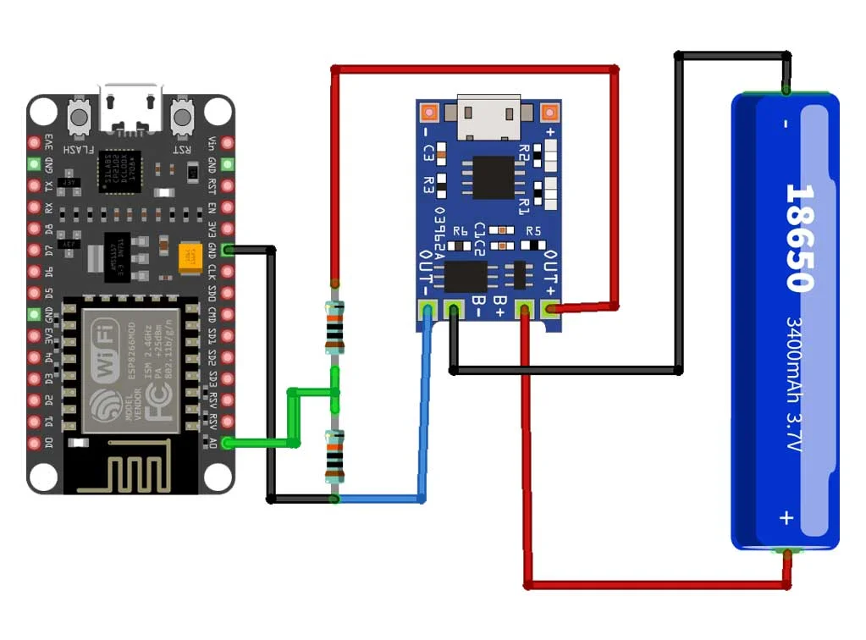
Circuit diagram

Slide 8
Objectives:
Ensure optimal performance
Long life of the battery
Monitors battery health
Monitors state of charge
Maintains charging and discharging processes
Protection against fire
Temperature monitoring
Overall safety
Efficiency increases
The adoption of electric vehicles increases rapidly

Slide 9
Components
NODEMCU ESP8266 Development Board
18650 Lithium Ion Battery
TP4056 Charging Module
Jumper Cables
100k Resistors
Breadboard

Slide 10

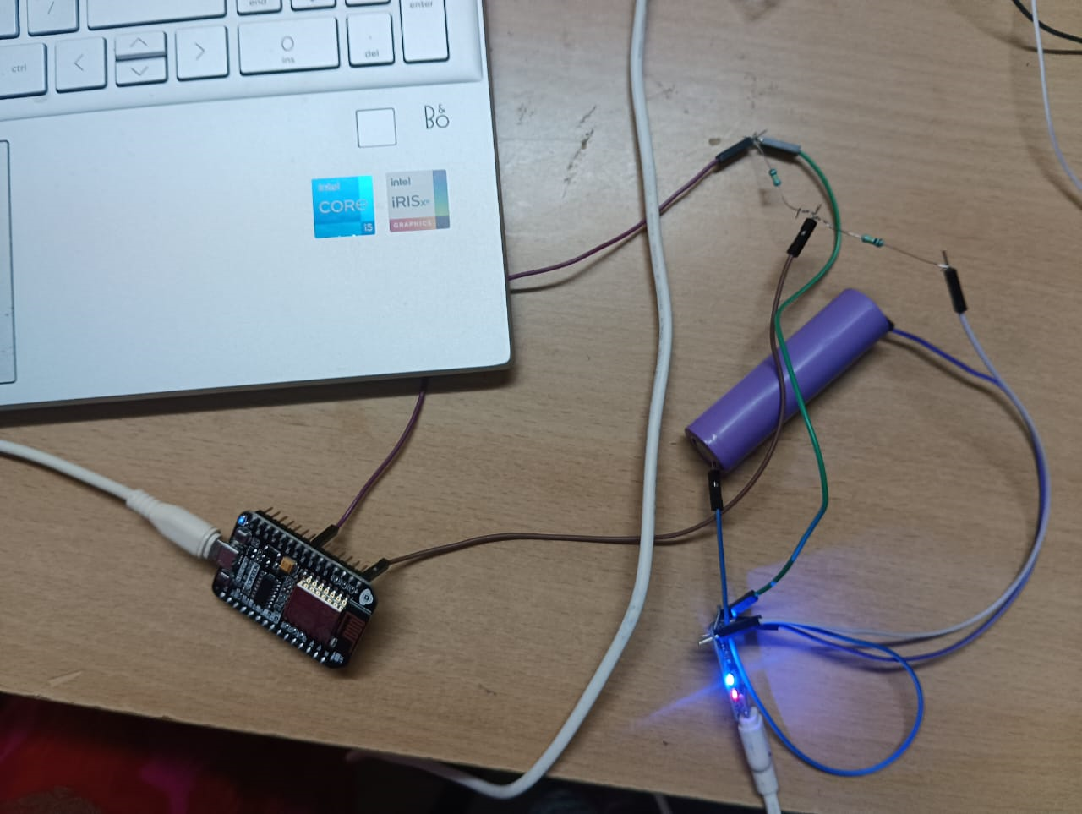
Mathematical Analysis / Model Design

Slide 11

.

Slide 12


Slide 13


Slide 14
Gantt Chart
Reviews | Review 1 | Review 2 | Review 3 | Review 4
Abstract Review
Literature Survey
Mathematical Analysis / Model Design
Component Testing/Simulation Design
Hardware/Simulation Implementation
Documentation & Results
Journals/Conferences Communication or published

Slide 15
References
[1]. S. Dhotre, S. S. Gavsane, A. R. Patil, and T. Nadu, International J of Eng & Technology. Innovative science vol. 1, no. 5, pp. 486–490, (2019).
[2]. .S. A. Mathew, R. Prakash, and P. C. John Int. Conf. Intel. Syst. Des. Appl. ISDA, pp. 189–193, (2020)
[3].https://www.researchgate.net/publication/350389634_Battery_Management_Systems_BMS_for_EV_Electric_
[4]. https://nevonprojects.com/ev-bms-with-charge-monitor-and-fire-protection/

